Slide 1
Announcements!
Quiz 7 (Due 10/20)
Exam 3 (11/1)
Research (11/28)

Slide 2
Chapter 11
Gender and Sex
© 2020 McGraw-Hill Education. All rights reserved. Authorized only for instructor use in the classroom. No reproduction or further distribution permitted without the prior written consent of McGraw-Hill Education
Notes:
© PhotoAlto/Alamy RF

Slide 3
Defining Sex
Properties that Determine Biological Sex as Male or Female:
  Genetically based on 23rd pair of chromosomes: XY or XX
  Biological Structures (ovaries, testes)
  gonadal hormones: estrogens or androgens play role in the development of:
    Internal/external reproductive structures
    secondary sex characteristics (at puberty)

Slide 4
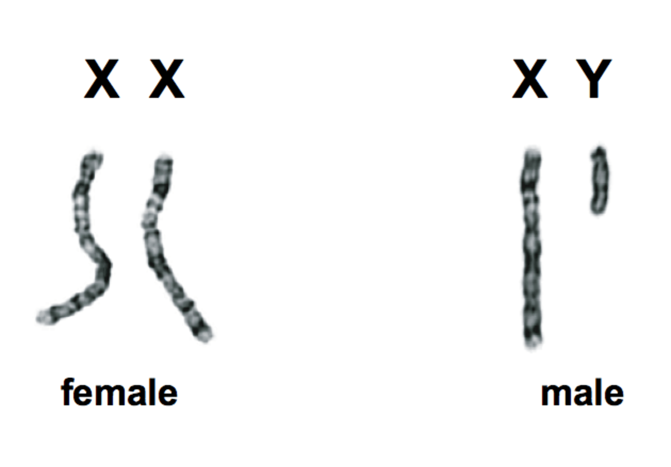
Male vs. Female Sex Chromosomes

Slide 5
Sexual Development: Beginning
Human eggs contain 23 chromosomes (Randomly selected from the mother’s 46)
Human sperm contain 23 chromosomes (Randomly selected from the father’s 46)
Mother ALWAYS contributes one X; father contributes one X OR one Y

Slide 6
Sexual Development: Prenatal
The SRY gene
  Provides instructions for male development
  Located on the Y chromosome
    Only males have this gene
  Kick-starts a process the blocks the development of female reproductive organs
Photo credit: © Nestle/Petit Format/Science Source

Slide 7
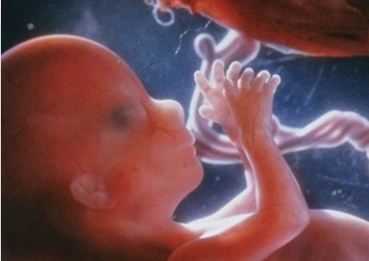
Sexual Development: Prenatal
Embryonic Development:
  Presence of SRY gene → testes →androgens → male physiology
  female is “default” condition
Photo credit: © Nestle/Petit Format/Science Source

Slide 8
Defining Gender
  Gender = Social and Psychological Aspects of Being Female or Male
  Sex and gender are not the same thing!
  Sex == Biological
  Gender == Social Aspects
Gender: assumptions regarding what constitutes ‘masculine’ or ‘feminine’ behaviour

Slide 9
Gender Stereotypes
Generalized view of attributes, characteristics, or roles that should be ascribed to each gender
Can be harmful when:
  Individuals are defined by gender stereotypes
  Capacity to pursue careers/personal lives is impeded
Can be hostile or benign:
  Hostile Examples: “Women are irrational; Men don’t show emotions”
  Benign Example: “All women are nurturing and can care for babies”

Slide 10
Gender Differences
Who are more . . .
Assertive?

Slide 11
Gender Differences
Who are more . . .
Caring?

Slide 12
Gender Differences
Who are more . . .
Rational?

Slide 13
Gender Differences
Who are more . . .
Aggressive?

Slide 14
Gender Differences
Who are more . . .
Talkative?

Slide 15
Gender Differences
Who are more . . .
Reserved?

Slide 16

Gender Identity
  One's innermost concept of self as male or female
    Refers to how individuals perceive themselves
  Not binary! Occurs on a spectrum:
    Most individuals identify closer to male or closer to female
    Some individuals a blend of both
    Some individuals feel like neither best describes them

Slide 17
Gender Identity
  One's gender identity can be the same or different from their biological sex
    Example: Transgender individuals
  Identify can be fluid or stable
    Some individual’s identities may change over time

Slide 18
Sexual Orientation
  An inherent, enduring emotional, romantic or sexual attraction to other people.
    Who you are attracted to and who you want to form relationships with
  Most people:
    Heterosexual
    Homosexual
    Bisexual
    Asexual
  Separate from Gender/Gender Identity!

Slide 19
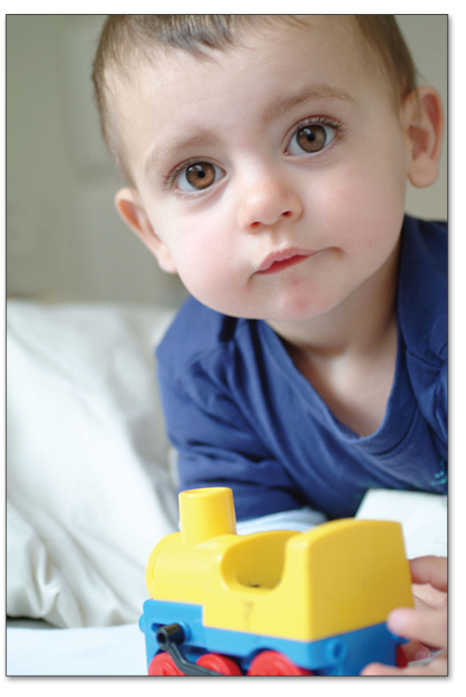
Gender Development (1)
Biological Accounts
  behavioral difference in newborns and infants
  Gender differences are innate, and pre-programmed

Slide 20
Gender Development (2)
Evolutionary Accounts
  selection pressures for gendered behaviors
    competition for mates (usually by male)
    preferences/choice for quality mate (usually by females)
    reproductive challenges: quality versus quantity

Slide 21
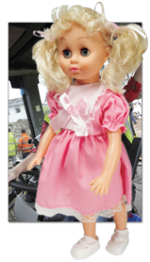
Gender Development (3)
Social Cognitive Accounts
  experience influences sense of gender
  socialization (rewards, punishments, modeling)
  gender schema (mental framework)

Slide 22
Gender Development (4)
Social Role Theory
  division of labor
    Members of each gender have natural differences that lend themselves to different tasks
      Example: Child-rearing vs. manual labor
      These differences become expected/socially ingrained
    Leads to gender roles and gender stereotypes

Slide 23
Gender Differences
Empathy & Helping
Cognitive Differences
  verbal performance?
  visuospatial ability?
  math and science?
Actual differences or just socialization?

Slide 24
Gender Differences
Differences in Aggression:
  overt aggression (physical/verbal harm)
    males more than females
  relational aggression (harm social standing)
    females more than males

Slide 25
Gender Differences
Differences in Sexuality
  females more selective regarding casual sex
  Why?
Explanations
  biological - genetic/hormonal differences
  evolutionary - sexual selection
  social cognitive - learned behavior
  social role - culturally constructed

Slide 26

Psychological Differences?
Common viewpoint that men and women are greatly different
  “Different Cultures”
Thoughts?

Slide 27
Gender Similarities Hypothesis
Men and women are similar on most psychological and educational traits:
  Self-esteem
  Self-disclosure
  Math performance
  Reading comprehension
Differences:
  Most differences involved motor function and aggression

Slide 28
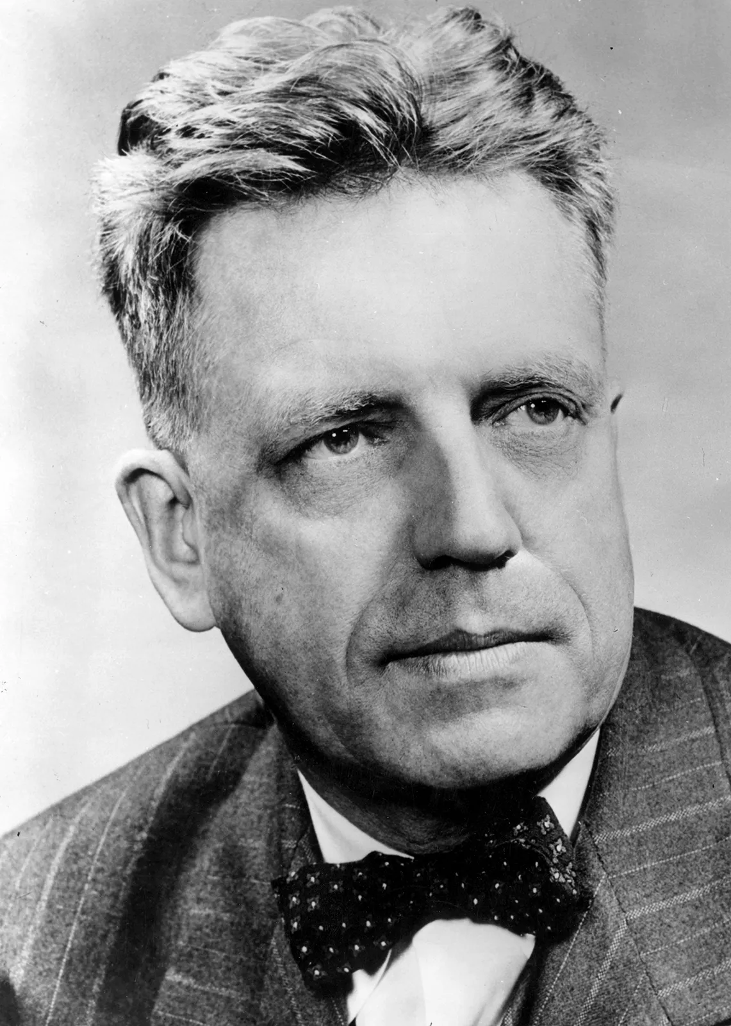
Research on Sexual Behaviors
Alfred Kinsey (1894 – 1956)
  Biologist most famous for his research on human sexual behaviors
  Widely regarded as the founder of sexology (scientific study of human behaviors)
  Controversial at the time (because 1940’s – 50’s…)

Slide 29
Kinsey’s Research
Did not just rely on theory
Interviews:
  Kinsey conducted face-to-face interviews with ~8000 individuals
    Asked personal questions about their relationship status and sex lives
    Interviewed anyone who was willing to talk to him
      Prisoners, Prostitutes, “homosexuals”, etc. (pretty progressive for the 1940’s)

Slide 30
Kinsey’s Research
Did not just rely on theory:
Observation
  Kinsey or colleagues would observe couples engaging in sexual intercourse
Other Sources of “data”
  Pornographic films
  Bathroom graffiti

Slide 31
Kinsey’s Research: Findings
69% of White males in US had sexual relations with prostitutes
~4% of American males were homosexual
~6% of American females were homosexual
Sexual relations tended to decrease over time for married couples

Slide 32
Kinsey Scale
Used to describe an individual’s sexual orientation
  Kinsey believed sexual orientation was fluid (i.e., does not neatly fit in two boxes)
Ranges from 0 – 6
  0 = Exclusively heterosexual
  6 = Exclusively homosexual

Slide 33
Kinsey’s Research: Criticisms
Sample disproportionately included prisoners, with many of whom were sex offenders
Also disproportionately included college students
May not have accurately reflected the population

